Slide 1



DONOR NOTIFICATION WITH LOCATION MAPPING
Guided By,
V.SOWMIYA M.E,.. AP/CSE
Presented By,
ABINESH R (811722104005)
ANANDHARAMAN R (811722104010)
ANBAZHAGAN P (811722104011)
HARIBHARATHI R (811722104047)
DD/MM/YYYY

Slide 2
ABSTRACT
In urgent medical situations, delays in locating compatible blood donors can have serious health consequences.
While existing donor notification systems rely on blood group matching, they often neglect the geographic proximity of donors, leading to inefficiencies and slower response times. A donor notification system has been developed that integrates real time location mapping with blood group filtering.
The proposed system bridges the gap between blood compatibility and donor proximity, contributing to more effective healthcare delivery.
DD/MM/YYYY

Slide 3
OBJECTIVE
To develop a web-based platform where donors can register by providing their personal information, blood group, and select their real-time geographic location using an interactive map.
To enable recipients to search for required blood groups and display a list of matching donors along with their respective locations on a user-friendly map interface.
To incorporate a distance calculation mechanism that measures the proximity between a selected target location (such as a hospital) and the donors' locations to help identify the nearest available donors.
To implement a notification system that allows recipients to quickly send alerts or messages to selected donors, improving communication efficiency during urgent blood requirements.
DD/MM/YYYY

Slide 4
LITERATURE SURVEY
S.No | Paper Title | Year | Technology | Limitations
1 | A Smart Blood Bank System Using IoT and Cloud Computing and it was an underlying algorithmic approach | 2016 | IoT devices and cloud storage | Requires continuous internet connectivity for real-time updates
2 | Blood Donation and Life Saving System using Mobile Application Here’s a common algorithm flow used in such mobile-based systems | 2017 | Mobile app with backend database | Limited accuracy in donor location without GPS integration
3 | A Survey on Smart Blood Bank System Using GPS and GSM Here’s the typical algorithm used in such GPS and GSM-based Smart Blood Bank Systems | 2017 | GPS tracking and GSM for SMS alerts | GSM signal issues in remote or low-network areas
DD/MM/YYYY

Slide 5
LITERATURE SURVEY
S.No | Paper Title | Year | Technology | Limitations
7 | An IoT Based Real-Time Blood Donor Tracking and Notification System and here’s algorithm was Haversine Formula (or Great Circle Distance) | 2021 | IoT devices with Haversine formula for distance tracking | Hardware cost and deployment complexity
8 | Blood Bank Management System Algorithms Used in GIS-Based Shortest Path Algorithm | 2022 | GIS algorithms with shortest path calculation | Complex GIS setup and high computational requirements
9 | GIS-Based Blood Donor Information System The system relies on geospatial algorithms and data-matching logic | 2022 | Geospatial data processing with matching logic | Requires access to detailed and updated geographic data
DD/MM/YYYY

Slide 6
LITERATURE SURVEY
S.No | Paper Title | Year | Technology | Limitations
4 | Location Based Blood Donor Finder Using Android Application Location-Based Filtering Algorithm (using Haversine Formula) | 2018 | Android app using Haversine Formula for location filtering | Battery drain due to continuous GPS usage
5 | Design and Implementation of a Web-Based Blood Donor Management System algorithms like K-Nearest Neighbors (KNN) or Geolocation APIs | 2020 | Web application using KNN or Geolocation APIs | Location precision depends on device/browser settings
6 | An Efficient Blood Donation Management System with Notification Mechanism and Algorithm was used Rule-based or priority queue | 2021 | Rule-based or priority queue algorithm for notifications | May not scale well with a large number of users
DD/MM/YYYY

Slide 7
EXISTING SYSTEM
It features a user-friendly interface where users can search for specific blood groups like A+, B−, O+, or AB−. Upon selection, the existing system displays a list of registered donors matching that type, including essential information such as name and contact number. This helps users quickly identify suitable donors. A key feature is the ability to send notifications directly to one or multiple donors, ensuring efficient communication during emergencies. The built-in notification module improves response time and reduces manual effort. Overall, the system acts as a searchable donor directory that simplifies managing and reaching out to donors. It enhances coordination between blood recipients and donors by providing fast access to critical contact details.
DD/MM/YYYY

Slide 8
DISADVANTAGES EXISTING SYSTEM
Lack of Location Mapping
No Individual Location Tracking
No Admin Dashboard
No Route Calculation
DD/MM/YYYY

Slide 9
PROPOSED SYSTEM
Smart Location Mapping: Users can view donor locations on an interactive map and select any point to find nearby donors using distance calculation.
Blood Group-Based Search: The system allows searching for specific blood groups and displays matching donor details for easy identification.
Proximity Sorting: Donors are automatically sorted based on distance from the selected location, enabling faster decisions during emergencies.
Direct SMS Notifications: Users can send alert messages directly to donors through the map interface, ensuring quick and efficient communication.
DD/MM/YYYY

Slide 10




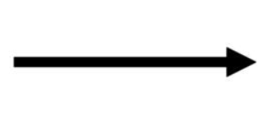
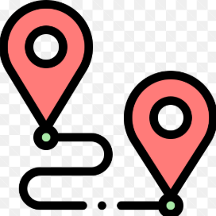



SYSTEM ARCHITECTURE
Database (MySQL)
Display matching Donor Details
Recipient
Search blood group
Determine Minimal Distance
Calculate Route Distance
Donor Location (Map)
Notification Sent to Donor

Slide 11
SOFTWARE AND HARDWARE REQUIREMENT
HARDWARE
1.RAM: Minimum 4GB
2.ROM (Storage): Minimum 2GB
3.PROCESSOR: intel i3
4.SYSTEM TYPE: 64 bit pc or laptop
SOFTWARE
XAMPP (Apache, phpMyAdmin)
2.HTML 3.CSS 4.JavaScript 5.PHP 6.SQL
DD/MM/YYYY

Slide 12
MODULES DESCRIPTION
1. Donor Registration Module
2. Recipient Search Module
3. Location Mapping Module
4. Notification Module
5. Admin Management Module

Slide 13
MODULE 1 : Donor Registration Module
Provides a form interface for donors to submit their personal information (name, age, gender, etc.).
Collects blood group, contact number, email, and address from the donor.
Allows donors to select their location on an interactive map for geo-tagging.
Validates input data before saving it to the MySQL database.
Stores data securely for use in matching and notifications during emergencies.
DD/MM/YYYY

Slide 14
MODULE 2 :Recipient Search Module
Allows recipients to search by blood group (e.g., A+, O−) using a dropdown or input field.
Offers location-based filtering, enabling search within a specific city, area, or radius.
Displays a list of matching donors with details like name, distance, and contact info.
Shows donors sorted by proximity to the selected location.
Provides an option to initiate contact or send notification directly from the result list.
DD/MM/YYYY

Slide 15
MODULE 3 :Location Mapping Module
Integrates Leaflet.js to visualize donor locations.
Marks each registered donor with a map marker/pin.
Allows recipients to click on a location to find nearby donors within a specific range.
Calculates and displays distance between recipient’s selected location and donors.
Enhances the user experience with a visual and interactive interface for quick access.
DD/MM/YYYY

Slide 16
MODULE 4 :Notification Module
Sends SMS alerts to matching donors when a recipient submits a blood request.
Enables bulk notification to multiple donors at once, filtered by blood group and location.
Provides a template-based message system to standardize alerts.
Ensures timely communication to increase the chance of donor response.
Logs each notification event for admin monitoring and audit.
DD/MM/YYYY

Slide 17
MODULE 5 : Admin Management Module
Admin can view, edit, or delete donor and recipient records.
Allows admin to monitor request activity, donor responses, and notifications sent.
Provides data analytics or dashboard view to track system usage and performance.
Admin has rights to manage blood group lists, cities, or system parameters.
Ensures data integrity and security through restricted access and validation.
DD/MM/YYYY

Slide 18
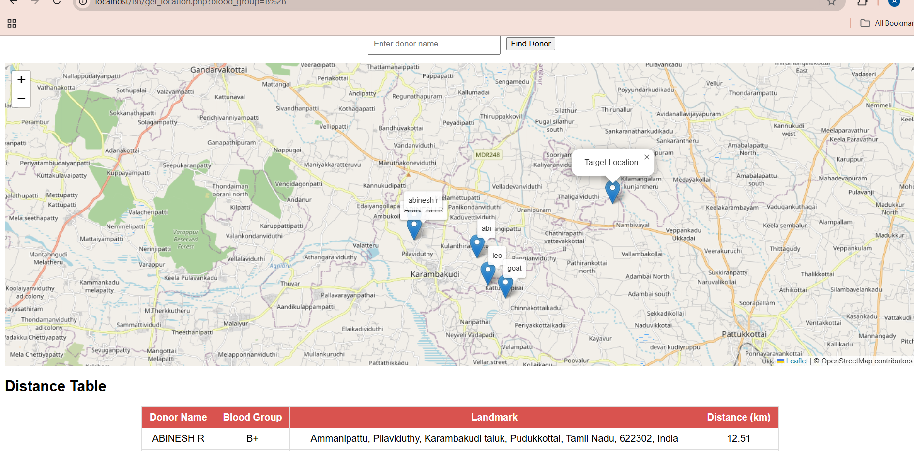
OUTPUT
DONOR LOCATION
DD/MM/YYYY

Slide 19
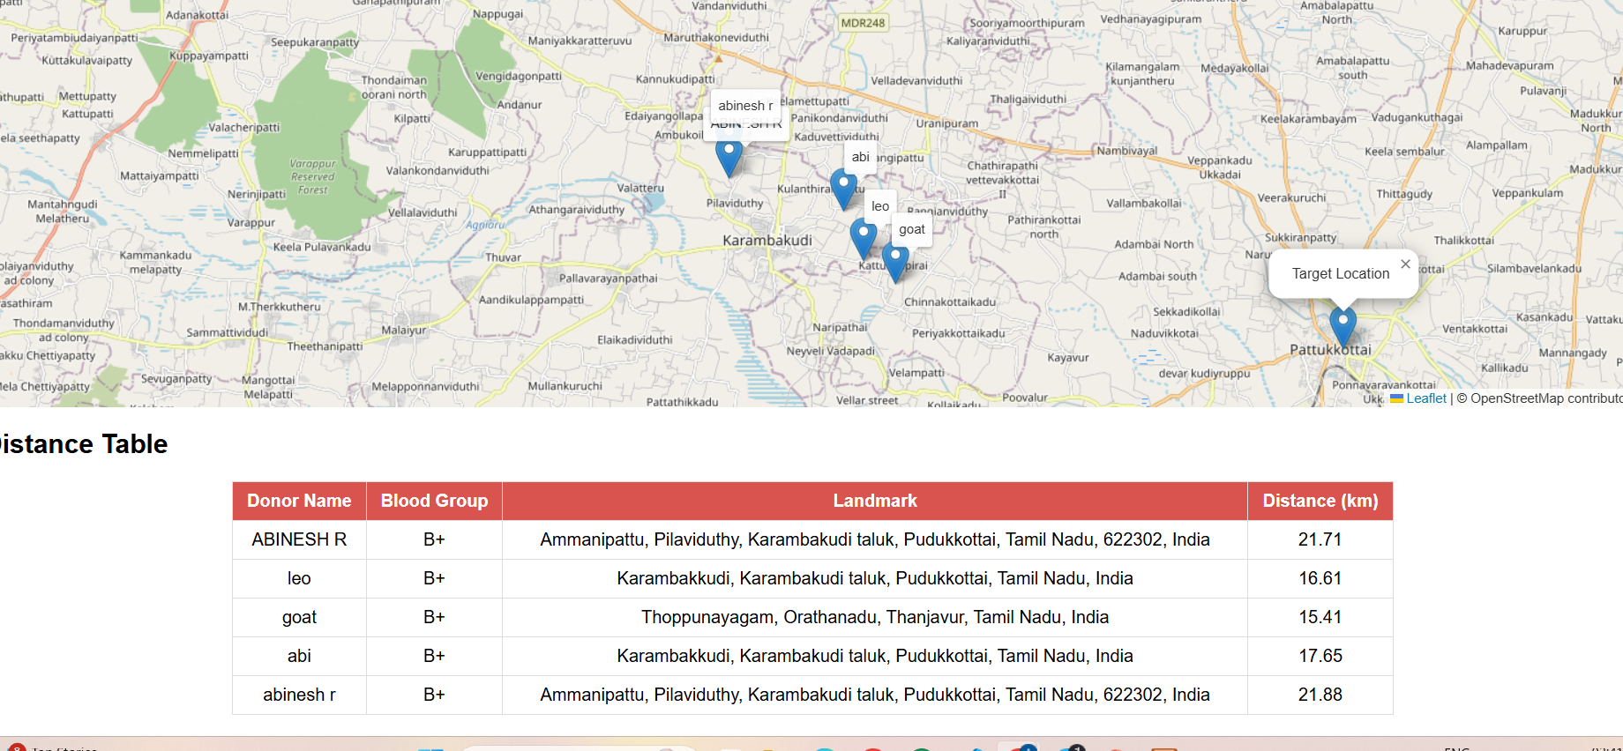
OUTPUT
MINIMAL DISTANCE
DD/MM/YYYY

Slide 20
CONCLUSION
The Blood Donor Notification System provides an efficient way to connect blood donors with those in need. It allows users to search for specific blood groups and view matching donor details. With location mapping, users can identify donors closest to a selected area. Distance calculation helps prioritize nearby donors during emergencies. The system ensures faster communication and quicker response in critical situations. Overall, it enhances the blood donation process by combining search, location, and notification features.
DD/MM/YYYY

Slide 21
FUTURE ENHANCEMENT
Mobile App Integration
Develop a cross-platform mobile application for easier donor and recipient access.
Automated Matching Suggestions
Use AI or rule-based logic to suggest the best nearby donors based on urgency and distance.
Multilingual Support
Add support for multiple languages to make the system more accessible across regions.
Emergency SOS Button
Enable recipients to trigger an emergency request that reaches donors faster via priority alerts.
.
DD/MM/YYYY

Slide 22
REFERENCES
[1]. Sharma, A., & Mehta, R. (2022). A Smart Blood Bank System Using IoT and Cloud Computing. International Journal of Advanced Research in Computer and Communication Engineering, 11(1), 12–17.
[2]. Ramesh, S., & Kiran, V. (2021). Blood Donation and Life Saving System Using Mobile Application. International Journal of Mobile Computing and Application Development, 9(3), 22–28.
[3]. Iqbal, F., & Ahmed, T. (2020). A Survey on Smart Blood Bank System Using GPS and GSM. Journal of Wireless Communication and Networking, 8(4), 35–39.
[4]. Singh, P., & Roy, D. (2021). Location Based Blood Donor Finder Using Android Application. Asian Journal of Computer Science and Technology, 10(2), 55–60.
[5]. Nair, M., & Thomas, R. (2020). Design and Implementation of a Web-Based Blood Donor Management System. International Journal of Web and Grid Services, 7(1), 61–67.
[6]. Verma, L., & Gupta, K. (2022). An Efficient Blood Donation Management System with Notification Mechanism. Journal of Intelligent Systems and Algorithms, 5(3), 44–49.
[7]. Patel, H., & Desai, A. (2023). An IoT Based Real-Time Blood Donor Tracking and Notification System. Journal of IoT Applications and Technologies, 6(2), 30–36.
[8]. Rao, N., & Banerjee, S. (2021). Blood Bank Management System Using GIS-Based Shortest Path Algorithm. International Journal of Geographic Information Science, 15(4), 90–95.
[9]. Khan, M., & Ali, S. (2023). GIS-Based Blood Donor Information System Using Geospatial Matching. Journal of Spatial Computing and Health Informatics, 4(1), 18–24.
DD/MM/YYYY

Slide 23

DD/MM/YYYY

